Slide 1
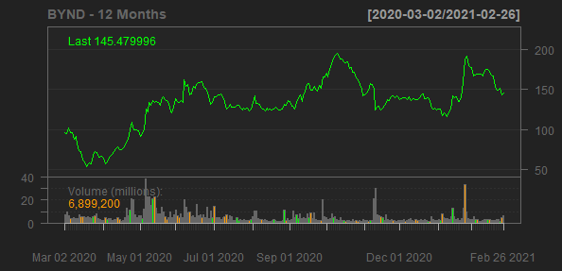
Beyond Meat, Inc.
BYND
Sector: Consumer Defensive
Industry: Packaged Foods
Beyond Meat, Inc., a food company, manufactures, markets, and sells plant-based meat products in the United States and internationally. It operates under the Beyond Meat, Beyond Burger, Beyond Beef, Beyond Sausage, Beyond Breakfast Sausage, Beyond Chicken, Beyond Fried Chicken, Beyond Meatball, the Caped Steer Logo, GO BEYOND, Eat What You Love, The Cookout Classic, The Future of Protein, and The Future of Protein Beyond Meat trademarks. The company sells its products through grocery, mass merchandiser, club and convenience store, natural retailer channels, direct to consumer, restaurants, foodservice outlets, and schools. The company was formerly known as Savage River, Inc. and changed its name to Beyond Meat, Inc. in September 2018. Beyond Meat, Inc. was founded in 2009 and is headquartered in El Segundo, California.
Sales Growth
EBIT Margin
250%
238.77%
1.47%
0%
200%
-7.75%
169.89%
150%
-20%
Sales Growth
EBIT Margin
-30.11%
100%
-40%
50%
36.55%
-60%
-65.69%
0%
2018-12-31
2019-12-31
2020-12-31
2017-12-31
2018-12-31
2019-12-31
2020-12-31
Date
Date

